Slide 1
Decentralized Information-Flow Control for ROS2
NDSS 2024
Nishit V. Pandya, Himanshu Kumar, Gokulnath M. Pillai, Vinod Ganapathy
Department of Computer Science and Automation Indian Institute of Science, Bangalore, India

Slide 2
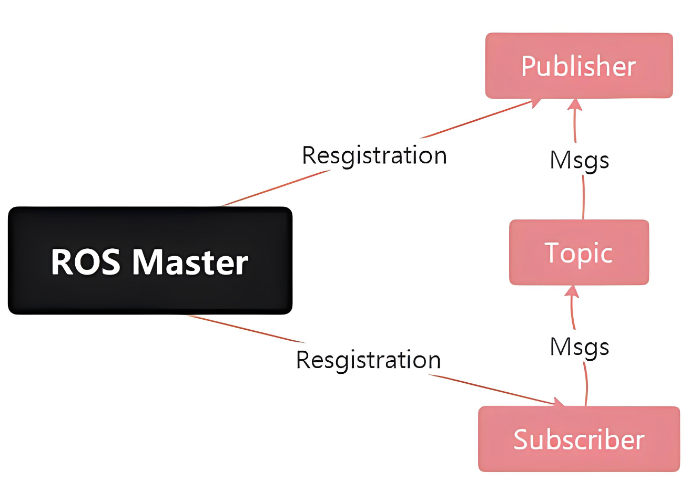
Problem Statement
ROS2 is a popular publish/subscribe based middleware that allows developers to build and deploy a wide-variety of distributed robotics applications.
ROS2 offers applications poor control over how their data is consumed downstream by other applications.
Decentralized information-flow control (DIFC) offers a solution to this problem, the decentralized and distributed architecture of ROS2 poses new challenges to building a practical DIFC system for ROS2.
need a centralized data exporter--violate ROS2’s design philosophy of decentralization
the security of the transmitted data cannot be guaranteed

Slide 3
Related Work
 | Related Work | Limit
ROS Security | add mandatory access control (MAC) policy enforcement to ROS secure the underlying DDS layer make TLS standard for all application communication | mostly focus on MAC policy, the issue of providing applications downstream control over their data remains open
DIFC | first introduced by Myers and Liskov[1] applied to several language-based systems, OSs, web services and mobile systems DStar[2] first generalized DIFC to distributed systems | need a centralized policy-enforcing TCB
Cryptographic Schemes for IFC | develop new cryptographic protocols for various elements of IFC improvement of protocols | not enforced on a real-world system
[1] A. C. Myers and B. Liskov. A decentralized model for information flow control. In ACM Symposium on Operating System Principles, 1997.
[2] N. Zeldovich, S. Boyd-Wickizer, and D. Mazi´eres. Securing distributed systems with information flow control. In Symposium on Networked System Design and Implementation, 2008.

Slide 4
Contributions
Propose the Picaros.
Picaros is the first to address the problem of applications downstream control over their data using DIFC, in which individual users can define DIFC tags to add to the data objects they produce. --control data flow, prevent data abuse
Picaros is tailored for the decentralized environment of ROS2, using decentralized multi-authority ABE as the core cryptographic primitive. Only applications that have the labels (decryption key) to access a data object will be able to successfully decrypt and obtain clear text. --realize decentralization, protect data confidentiality
Picaros is the first practical implementation applied to enforce DIFC on a real-world system (ROS2).

Slide 5
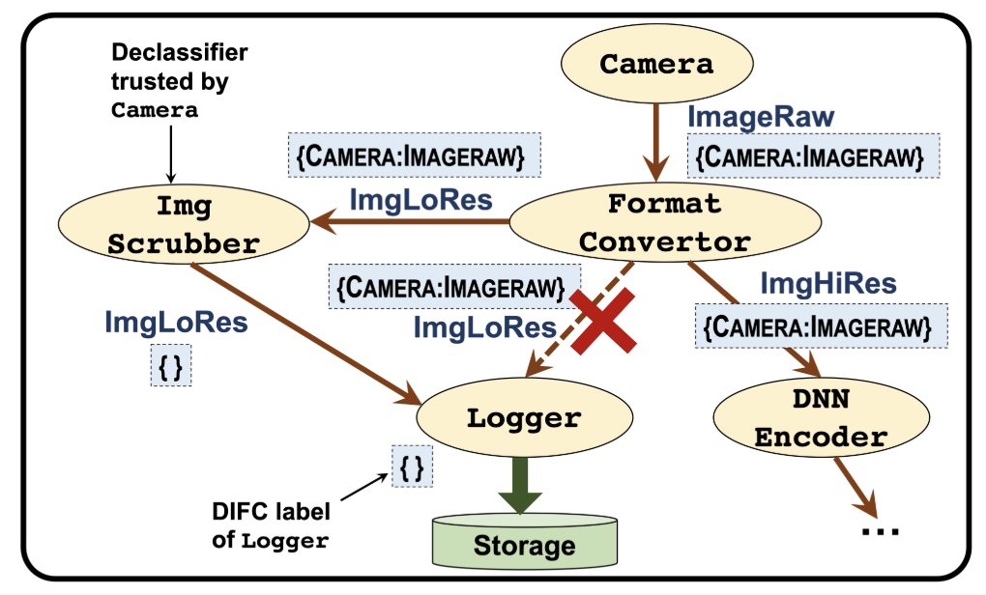
DIFC to enforce control over data
send an explicit request for tag
topic
Label:{Application name 1: data type 1, Application name 2: data type 2, ..., Application name n: data type n, }
Step1: Camera adds a tag {Camera: ImageRaw} to the label of its output data
Step2: FormatConvertor sends a request to Camera to add this tag
Step3: FormatConvertor generates two topics: ImgLoRes, ImgHiRes
Step4: Logger and DNN Encoder sends a request to Camera to add this tag
ImgScrubber: trusted by Camera, removes the tag, satisfy Camera’s privacy needs

Slide 6
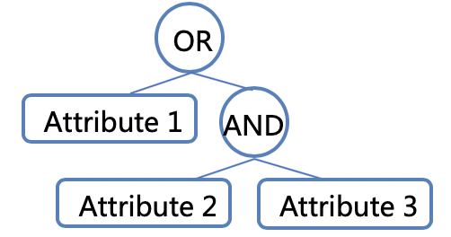

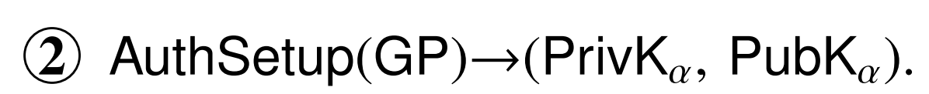
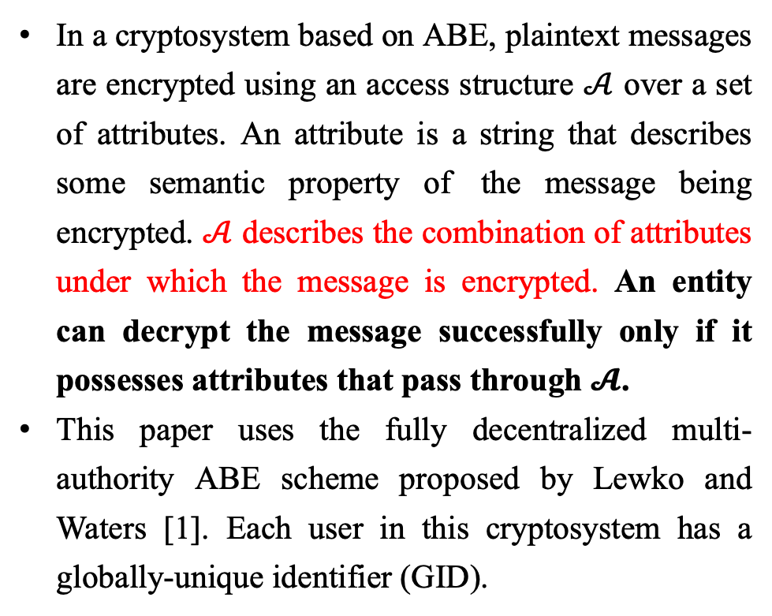
Attribute-based Encryption--ABE
Access tree structure example
Boolean Structure
In a cryptosystem based on ABE, plaintext messages are encrypted using an access structure $𝒜$ over a set of attributes. An attribute is a string that describes some semantic property of the message being encrypted. $𝒜$ describes the combination of attributes under which the message is encrypted. An entity can decrypt the message successfully only if it possesses attributes that pass through $𝓐$.
This paper uses the fully decentralized multi-authority ABE scheme proposed by Lewko and Waters [1]. Each user in this cryptosystem has a globally-unique identifier (GID).
Step
[1] A. Lewko and B. Waters. Decentralizing attribute-based encryption. In Advances in Cryptology—Eurocrypt, 2011.

Slide 7
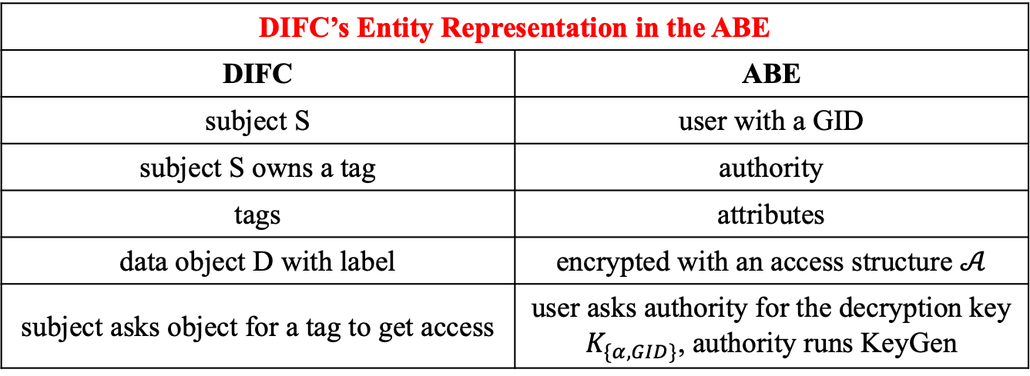
DIFC Using ABE
DIFC’s Entity Representation in the ABE
DIFC | ABE
subject S | user with a GID
subject S owns a tag | authority
tags | attributes
data object D with label | encrypted with an access structure $𝒜$
subject asks object for a tag to get access | user asks authority for the decryption key $K_{\{α, GID\}}$, authority runs KeyGen
data objects will be always encrypted as they are passed between subjects
ensure the label is securely bound to object and cannot be changed
*Traditional DIFC: the enforcement mechanism determines whether a data object must be released to a requesting subject mandatory, needs a priori
In the ABE-based realization, the (encrypted) data object is released to the subject. However, only subjects with the required attributes will be able to procure the keys to successfully decrypt the object.

Slide 8
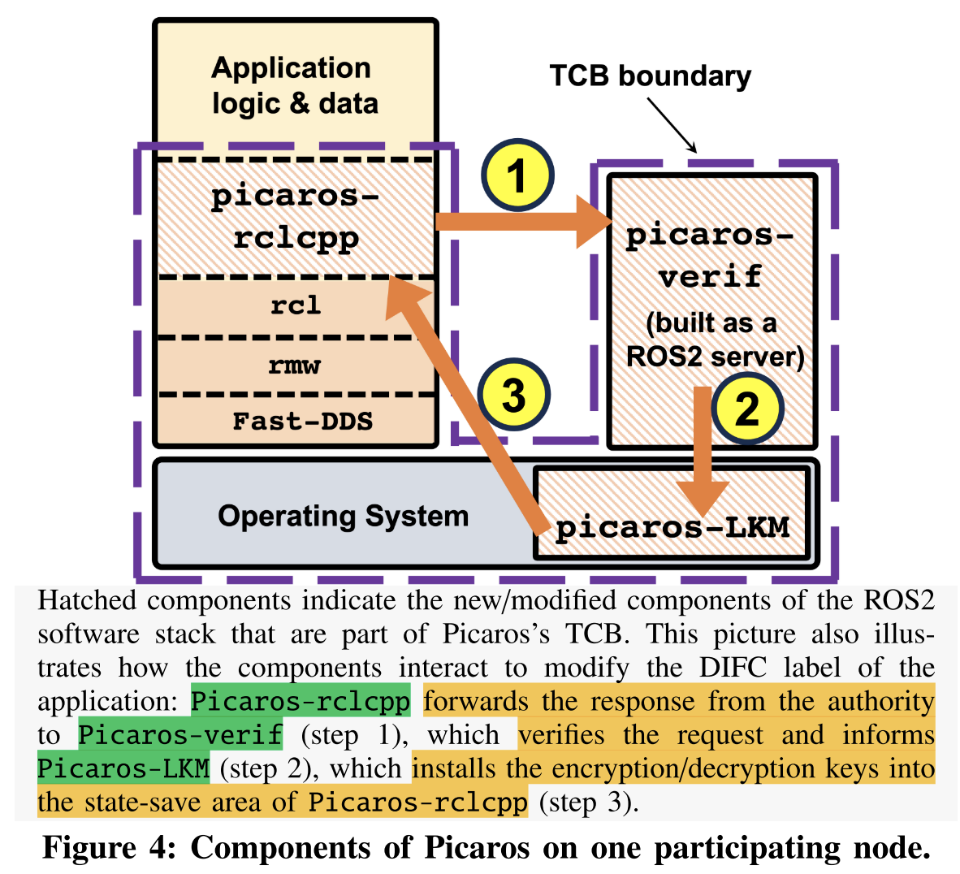
Implementation of Picaros
rclcpp: the library that provides ROS2’s API
Picaros-rclcpp: invoke Encrypt + Decrypt
Picaros-LKM: a loadable kernel module that securely stores encryption/decryption keys and GID in the kernel
Picaros-verif: implemented as a user-space ROS2 server
TCB includes Picaros-rclcpp, Picaros-LKM, Picaros-verif, the OS and all supporting libraries, is realized with hardware support in the form of memory domains
client library
middleware

Slide 9
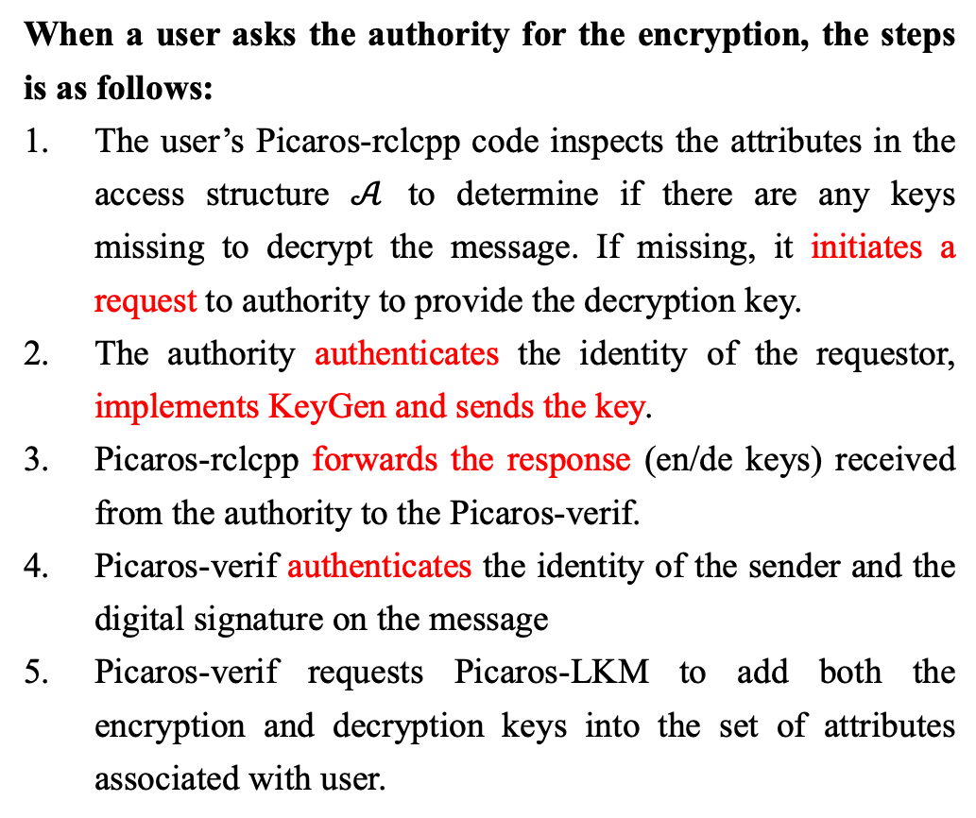
Implementation of Picaros
When a user asks the authority for the encryption, the steps is as follows:
The user’s Picaros-rclcpp code inspects the attributes in the access structure $𝒜$ to determine if there are any keys missing to decrypt the message. If missing, it initiates a request to authority to provide the decryption key.
The authority authenticates the identity of the requestor, implements KeyGen and sends the key.
Picaros-rclcpp forwards the response (en/de keys) received from the authority to the Picaros-verif.
Picaros-verif authenticates the identity of the sender and the digital signature on the message
Picaros-verif requests Picaros-LKM to add both the encryption and decryption keys into the set of attributes associated with user.

Slide 10
Threat Analysis
Unauthorized DIFC label modification
Malicious application: read data objects that it is not authorized to, by adding tags to its DIFC label; leak information by removing tags of other authorities from its DIFC label
tag additions of the DIFC label = = add encryption key of the corresponding attribute
Picaros-verif prevents this kind of unauthorized modification
verify the requests to add encryption keys (check the authenticity of the message’s resource and its contents)
verify the requests to add decryption keys to the application’s keystore
verify the requests to delete of public keys by declassifiers

Slide 11
Threat Analysis
Collusion attacks
User A has decryption keys for attribute α + User B has decryption keys for attribute β
⬇️ collude
obtain the ability to decrypt a message that has both attributes
Lewko-Waters ABE construction prevents this attack by customizing decryption keys based on the user’s GID.
Picaros: Picaros-rclcpp sends Keygen requests to the authority over TLS, with the GID retrieved from Picaros-LKM. Authorities verify that the source of this request matches the GID of the requestor, and only send the customized decryption key to Picaros-rclcpp.
read-protecting decryption keys

Slide 12
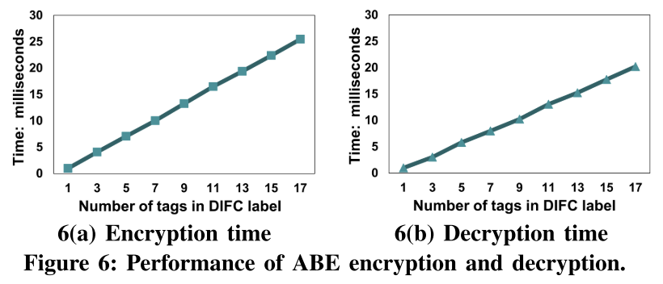
Evaluation
Encryption and Decryption Performance
two-node pipeline: one publisher and one subscriber
message size: 128 bytes
raw cost: milliseconds level, increase linearly with the number of tags

Slide 13
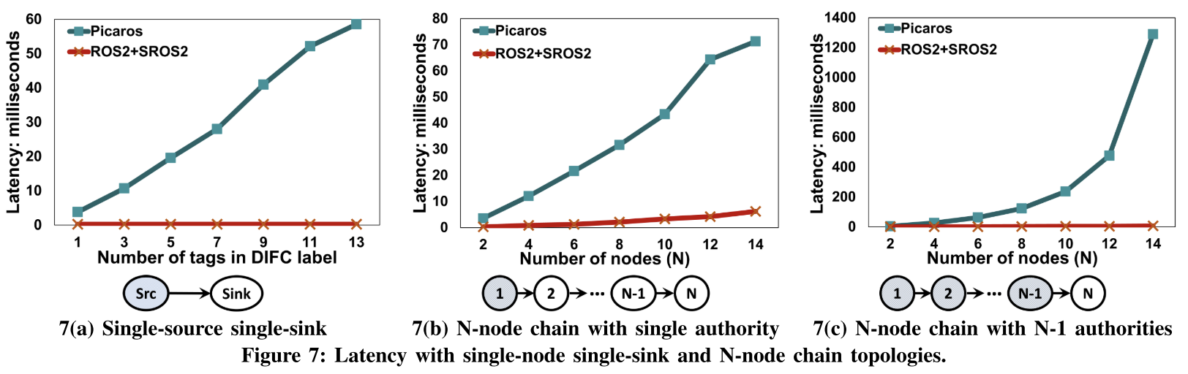
Evaluation
Microbenchmark Latency
end-to-end latency: time elapsed between the publication of a message at a source node (publisher) to its delivery at a sink node (subscriber) in various ROS2 application pipelines
baseline: ROS2+SROS2
three pipelines

Slide 14
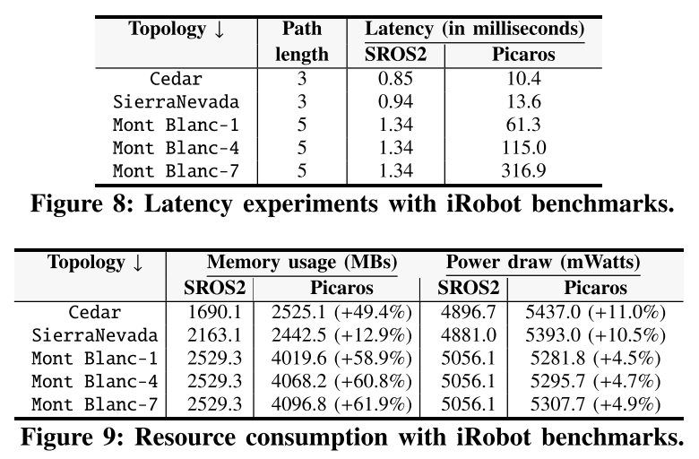
Evaluation
End-to-end Benchmark Performance
use benchmarks from the iRobot suite
baseline: SROS2
Cedar, Sierra Nevada: 10-node application pipelines
Mont Blanc: a 20-node topology, repeat the experiment with three configurations, in which there are 1, 4 and 7 authorities
resource consumption: memory usage and power consumption

Slide 15
Innovation
The DIFC + ABE decentralized scheme could be used in the UAV scenario for applications encryption communication, and it may be able to expand further into the UAV fleet.
The performance of ABE encryption and decryption is suitable and acceptable for UAV, and it may be better than other cryptographic algorithm.
DIFC systems generally have separate labels for secrecy and integrity. This paper only focuses on secrecy labels in their solution. It seems that considering the integrity labels can be a solution to fix the problem of data integrity guarantee.

Slide 16
THANKS

